Slide 1
Erasure conversion in integer fluxonium qubits
Jiakai Wang, Raymond Mencia, Vlad Manucharyan, Maxim Vavilov
UW-Madison, EPFL

Slide 2
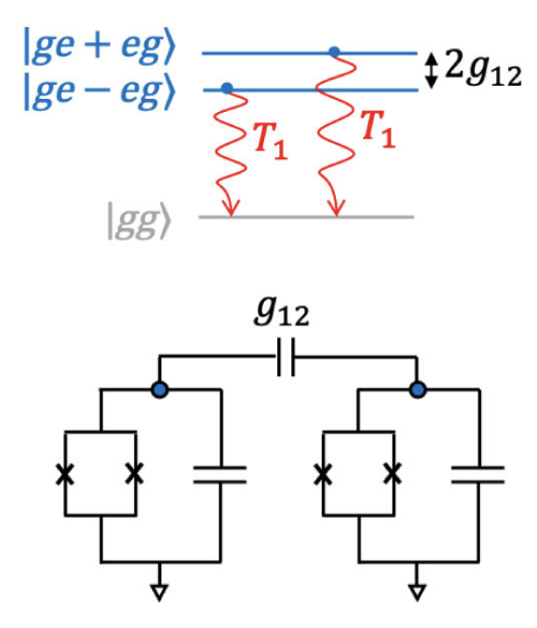
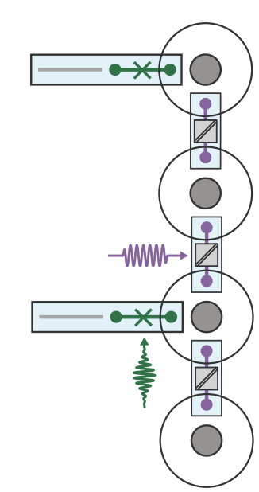
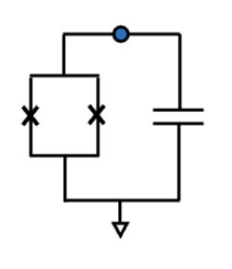
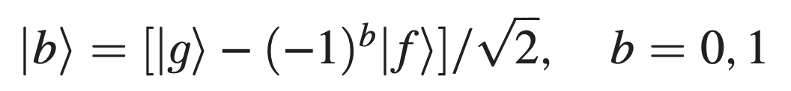
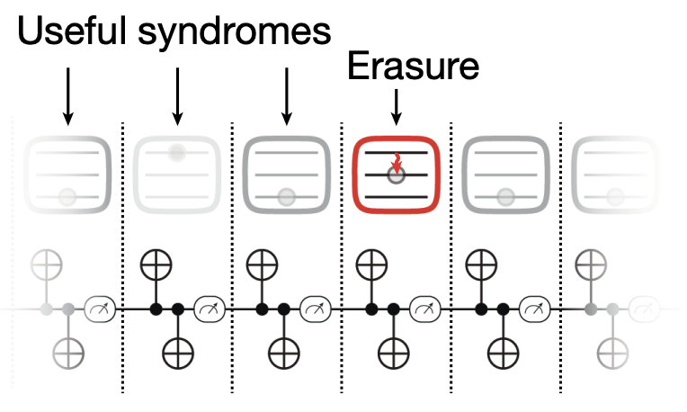
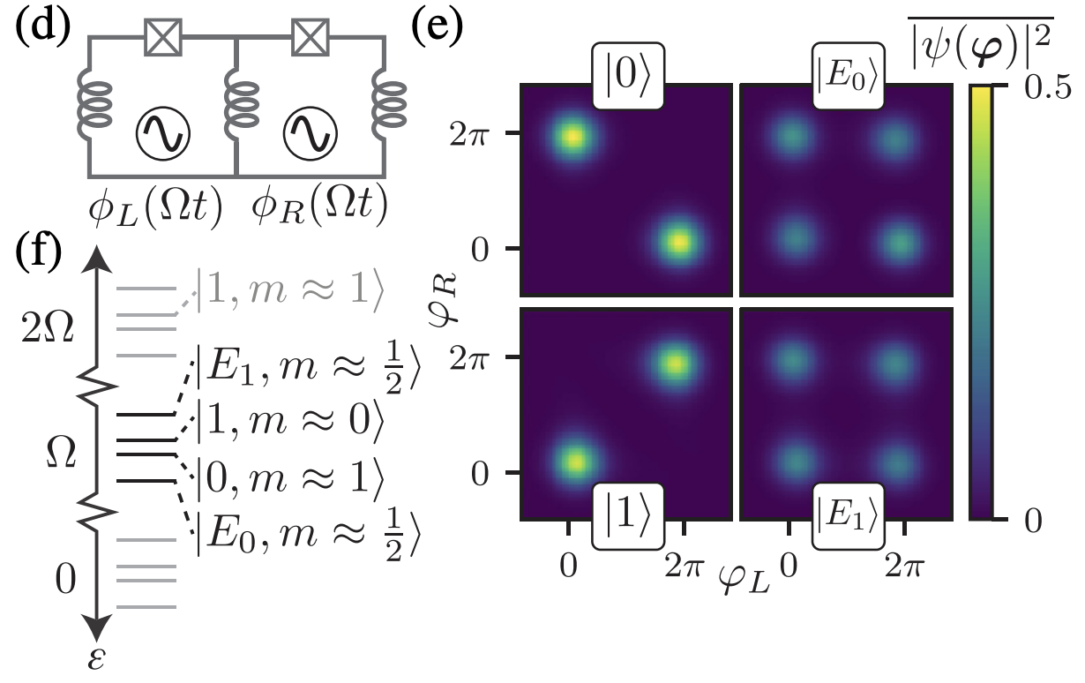
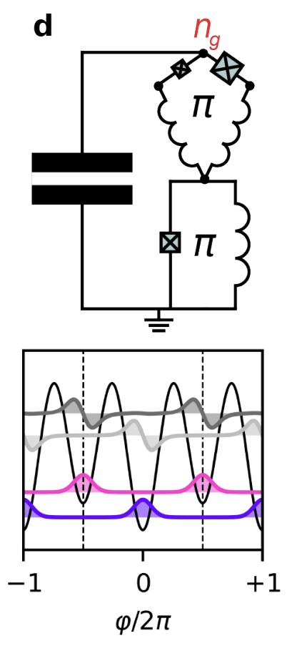
Single mode erasure qubit
Multi-mode erasure qubit
Dual rail transmon
Dual rail cavity
Spin-locked g-f transmon
A. Kubica et al. Phys. Rev. X 13, 041022 (2023)
g-f transmon ancilla for cat qubits
A. Kubica et al.
Phys. Rev. X 13, 041022 (2023)
H. Levine et al.
Phys. Rev. X 14, 011051 (2024)
Koottandavida et al.
Phys. Rev. Lett. 132, 180601 (2024)
and a lot more…
Floquet fluxonium molecule
Harmonium
H. Putterman et al. Nature volume 638, pages927–934 (2025)
Are there good single mode erasure data qubits?
M. Hays et al.
arXiv:2502.15459 (2025)
M. Thibodeau et al.
PRX Quantum 5, 040314 (2024)
J. An, H. Zhang Erasure Qubits Based on Fluxonium Circuits Wednesday L17

Slide 3
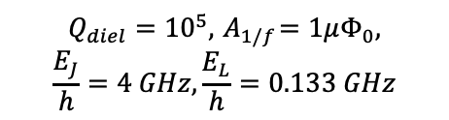
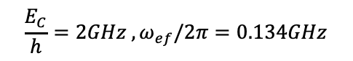
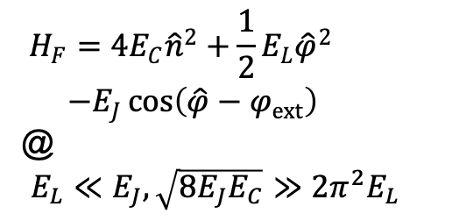
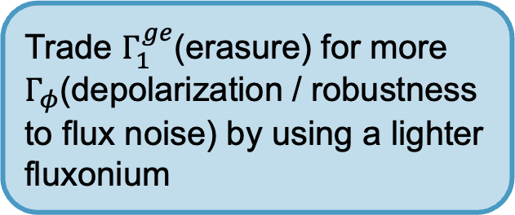
Integer fluxonium qubit: g-e-f subspace with good coherence
$$H_{F}=4E_{C}{\hat{n}}^{2}+\frac{1}{2}E_{L}{\hat{φ}}^{2}$$
$−E_{J}\cos\left(\hat{φ}−φ_{ext}\right)$
@
$E_{L}≪E_{J}, \sqrt{8E_{J}E_{C}}≫2π^{2}E_{L}$
Trade $Γ_{1}^{ge}$(erasure) for more $Γ_{φ}$(depolarization / robustness to flux noise) by using a lighter fluxonium
$$Q_{diel}={10}^{5},{ A}_{1/f}=1μΦ_{0},$$
$$\frac{E_{J}}{h}=4 GHz,\frac{E_{L}}{h}=0.133 GHz$$
$$\frac{E_{C}}{h}=2GHz ,ω_{ef}/2π=0.134GHz$$

Slide 4
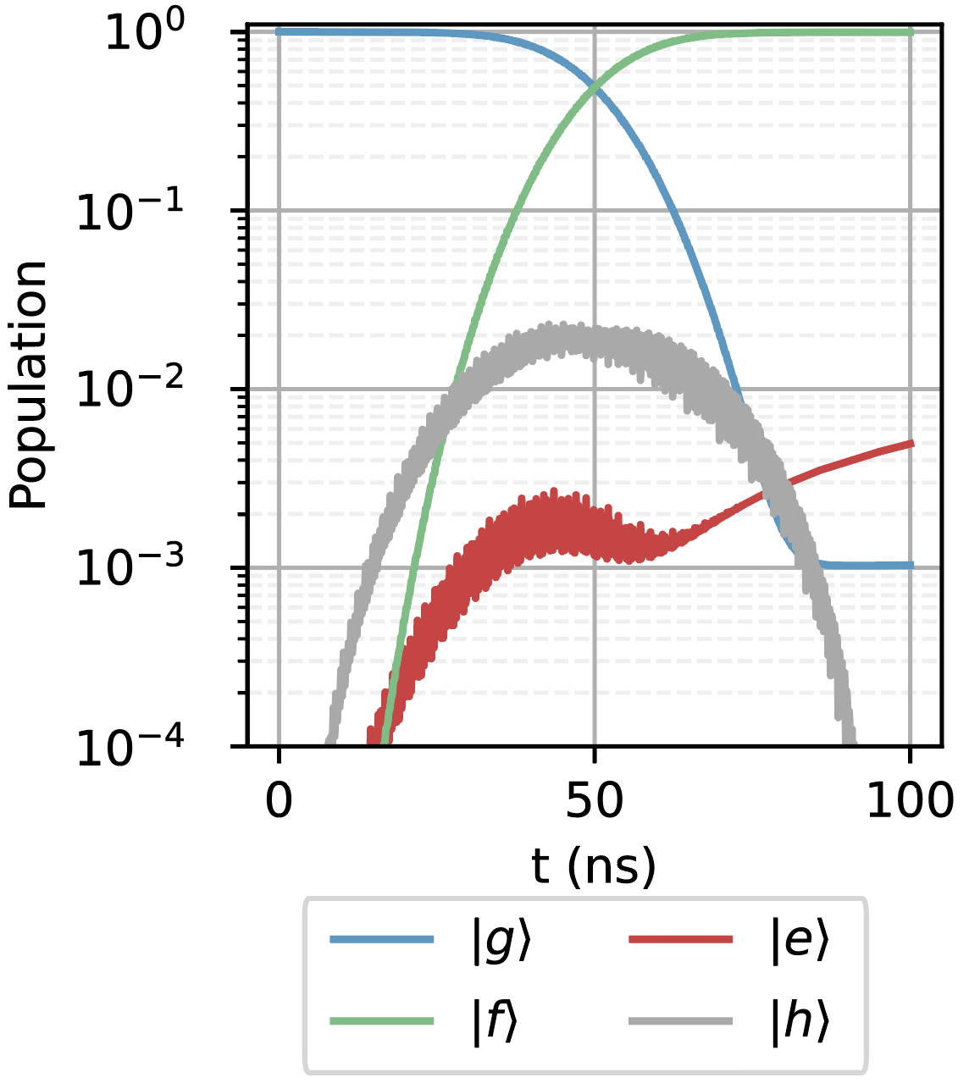
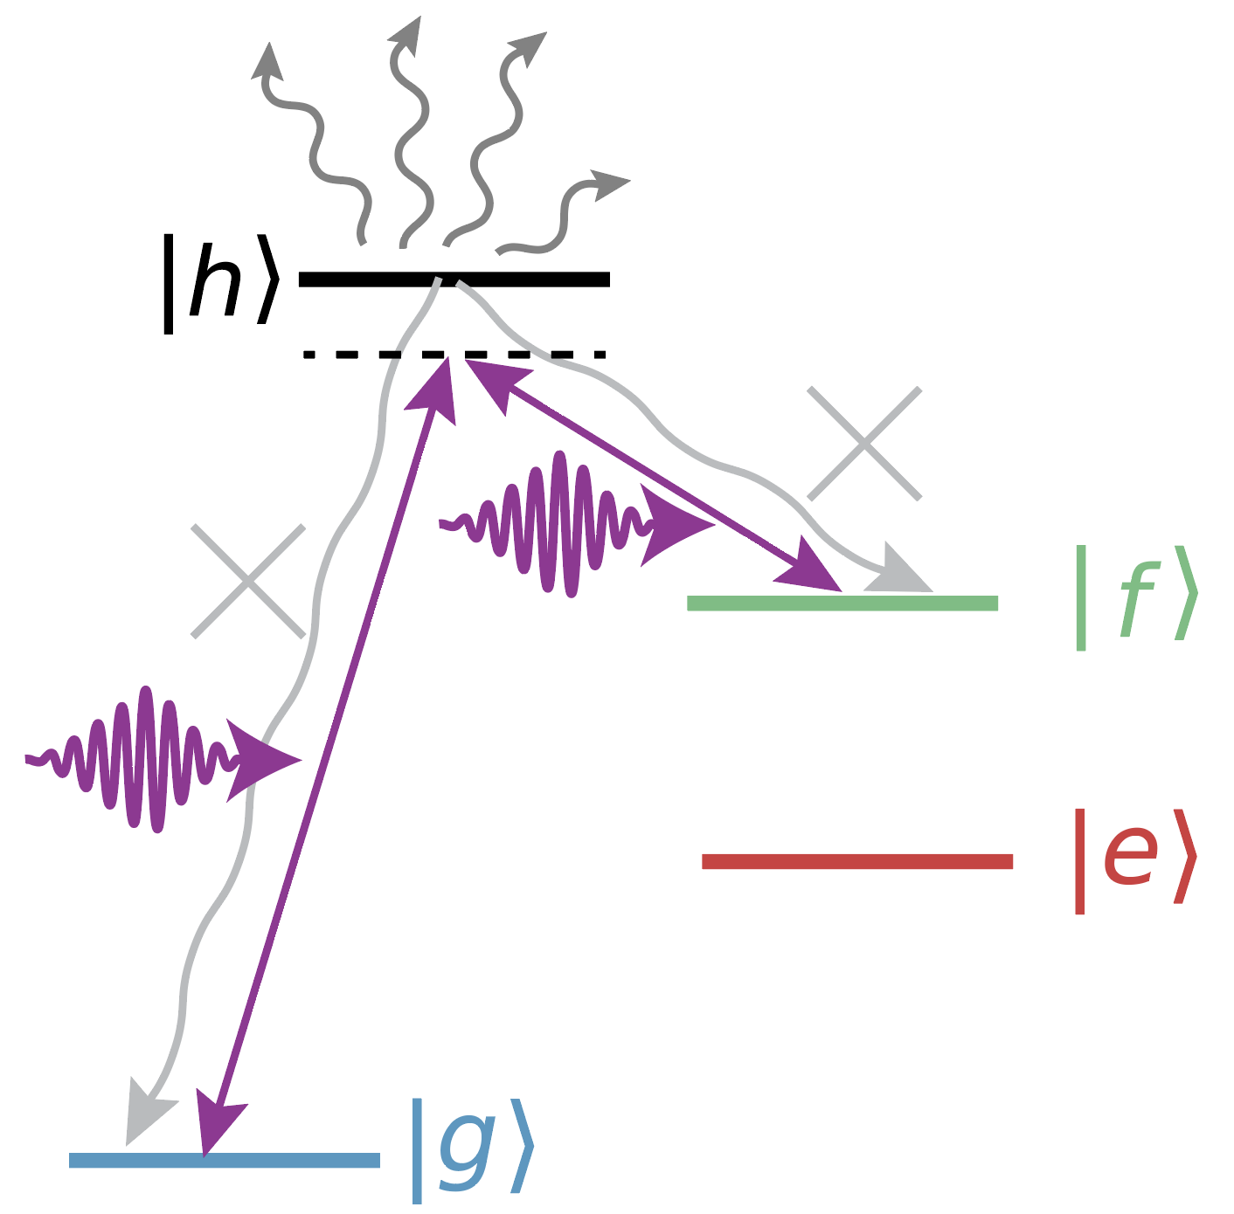
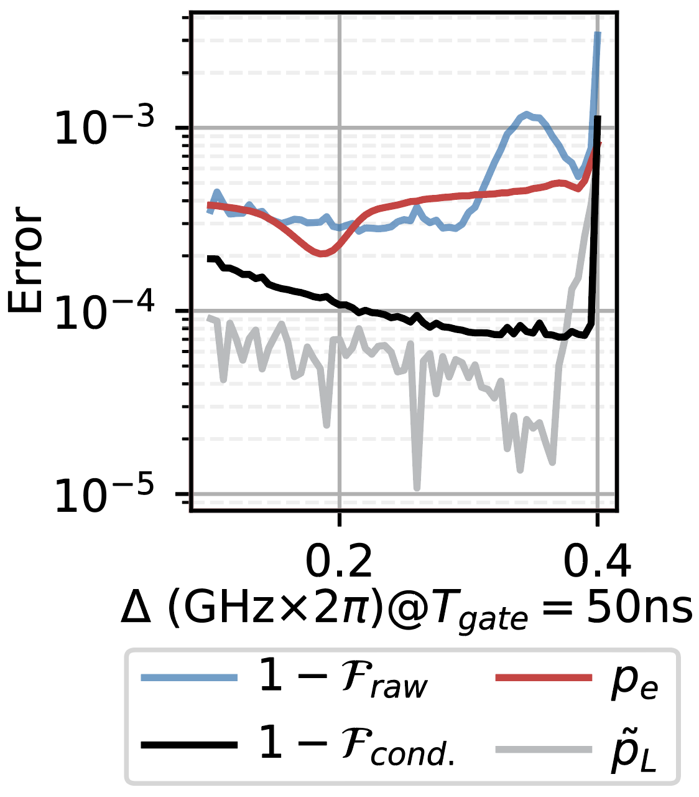
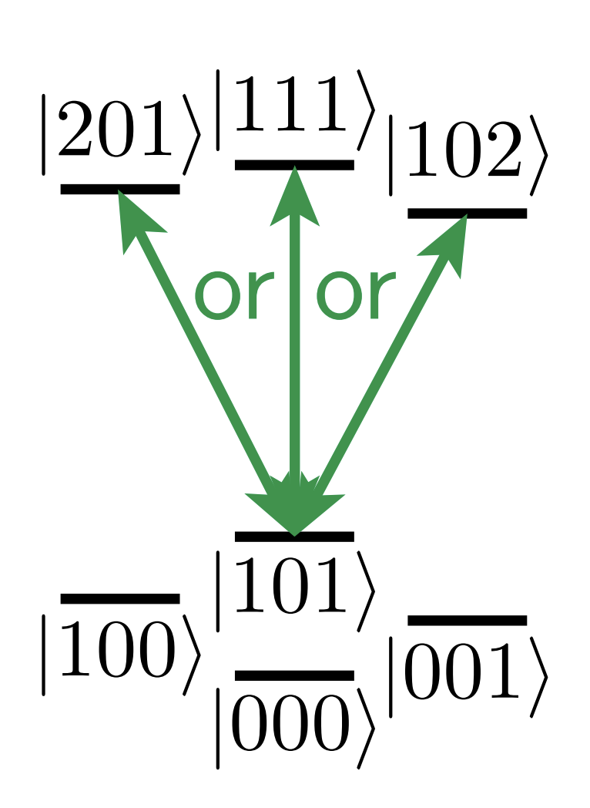
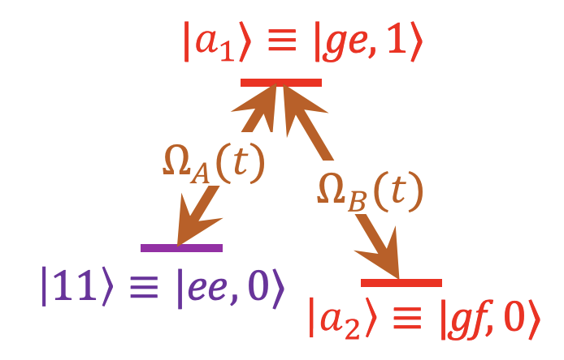
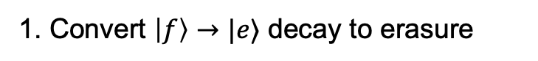
Erasure conversion of actual gate errors in fluxonium
3. Correct additional leakage with erasure conversion on higher levels.
Leakage be mitigated by accelerated adiabatic gates (F. Setiawan et a. PRX Quantum 2, 030306 (2021) )
1. Convert $\left|f\right\rangle →|e⟩$ decay to erasure
The same idea applies to entangling gates that involve higher levels
2. Reduce intermediate-state decay by dark state transition
L. Ding et al.
Phys. Rev. X 13, 031035
(2023)
F. Setiawan et al.
Phys. Rev. Applied 19, 034071
(2023)

Slide 5
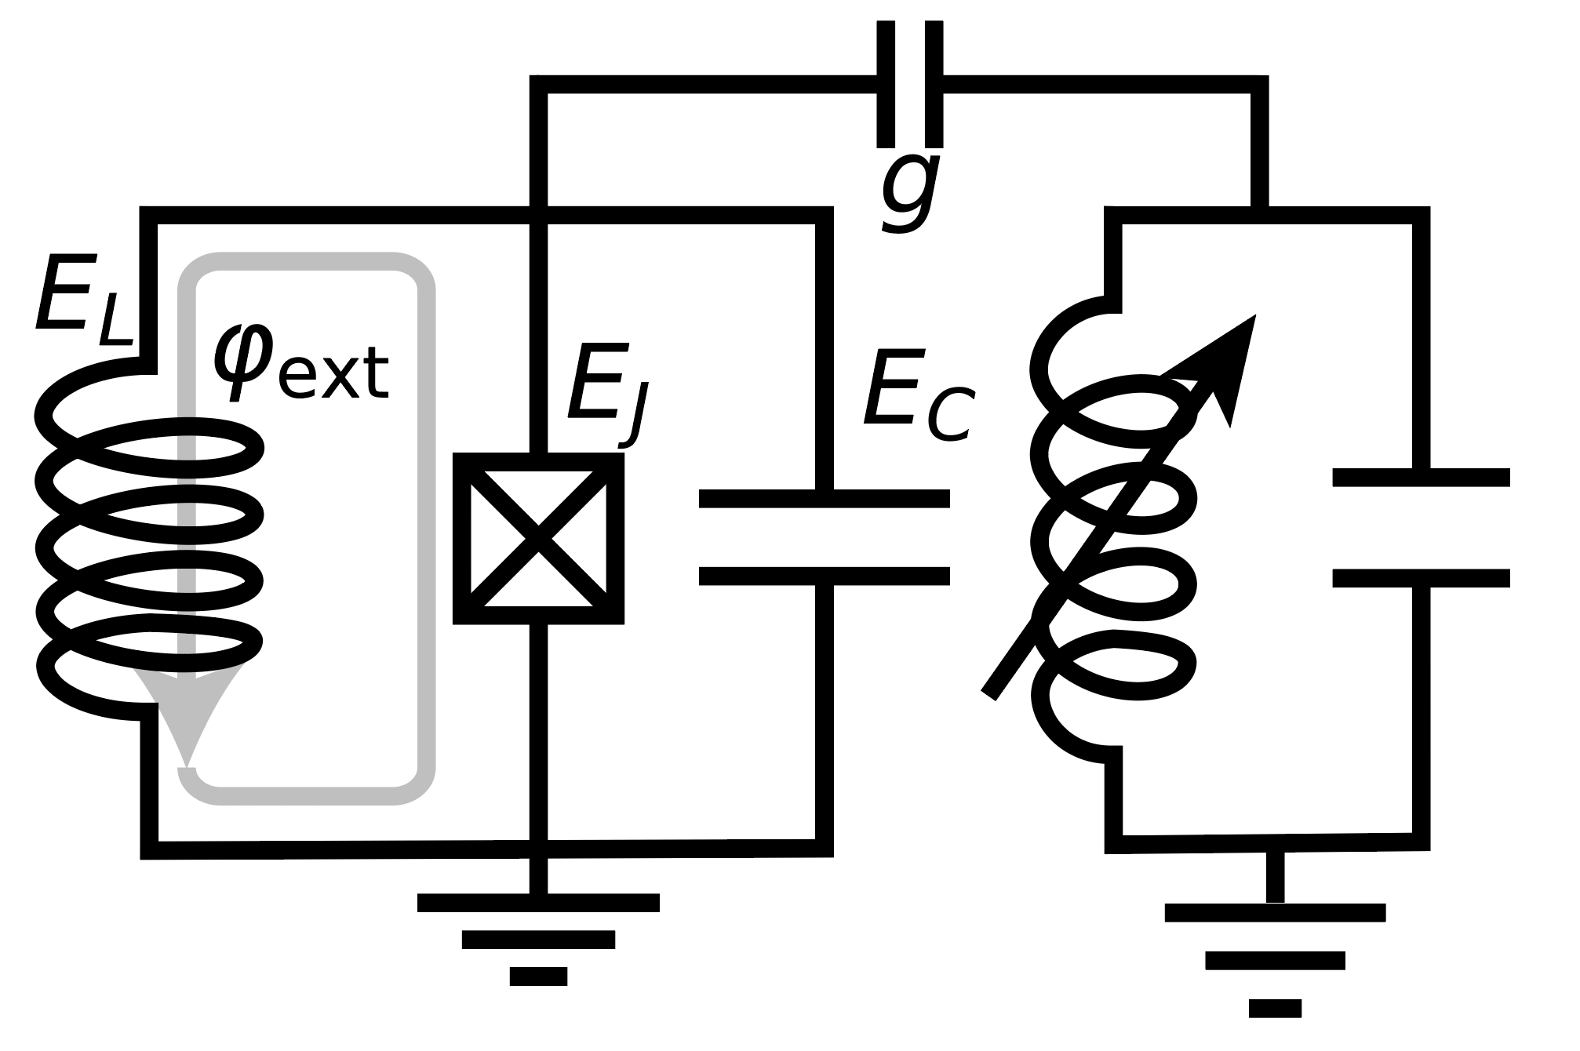
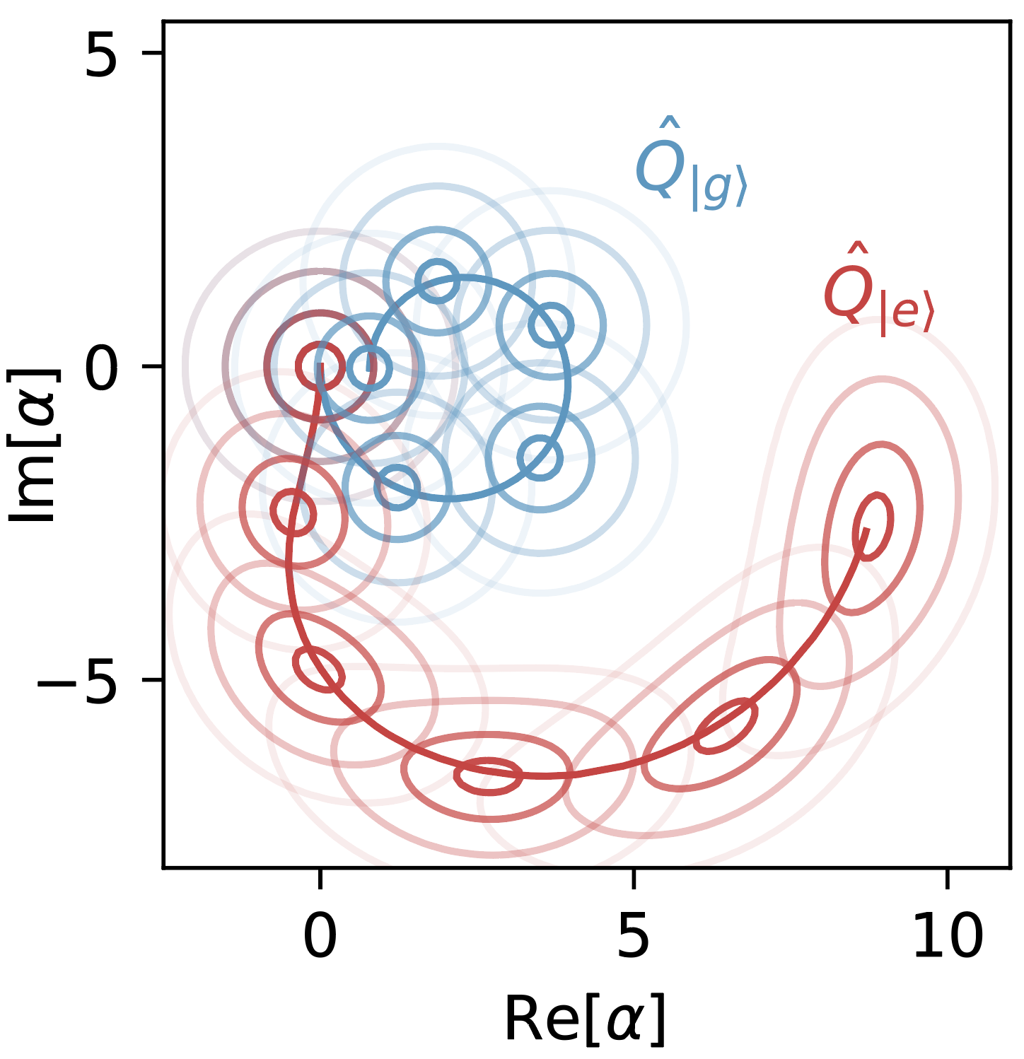
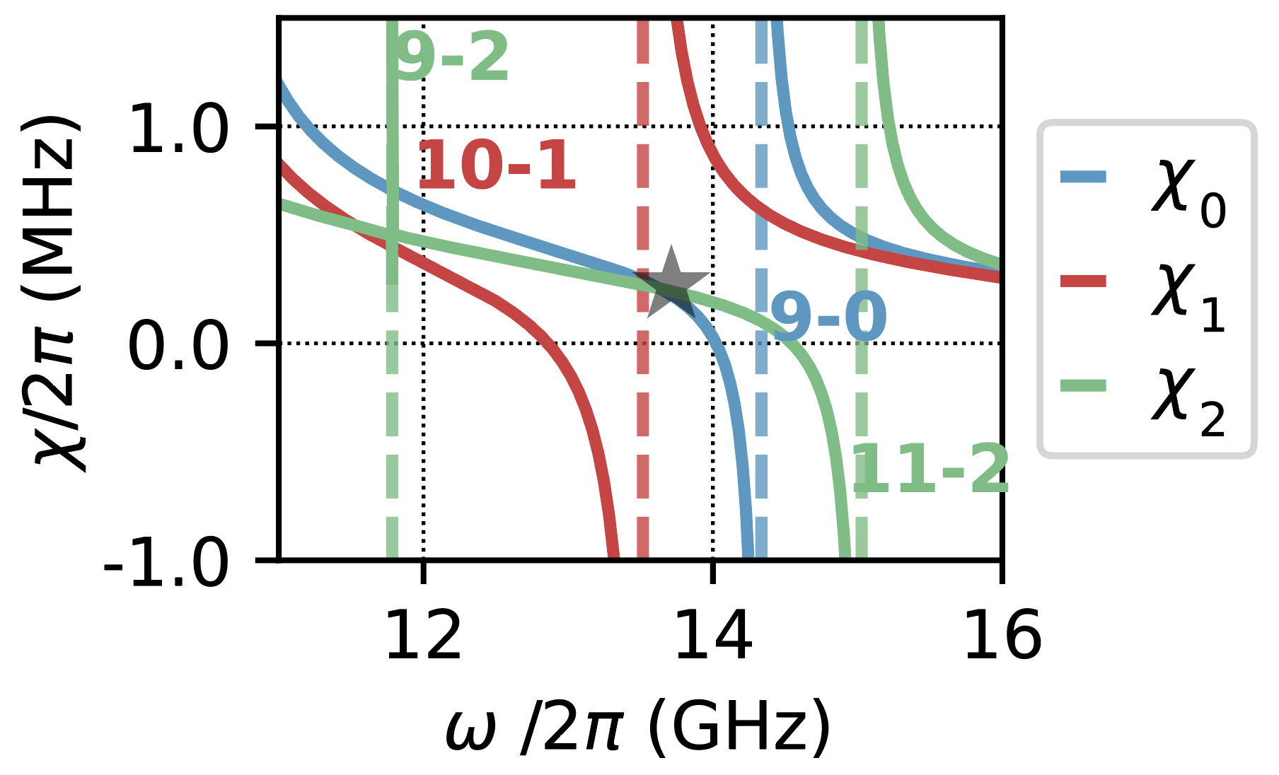
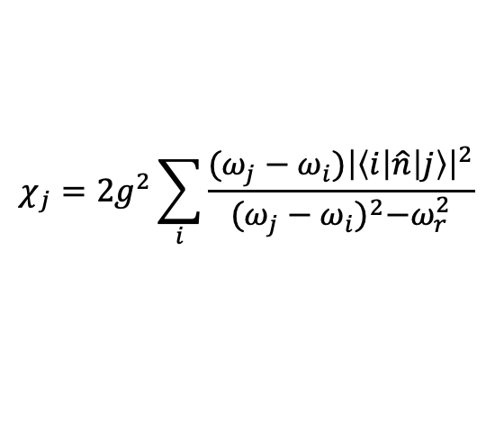
Dispersive erasure detection: concept and SNR
$$χ_{j}=2g^{2}\sum_{i}{\frac{(ω_{j}−ω_{i}){\left|\left\langle i | \hat{n} | j\right\rangle \right|}^{2}}{{(ω_{j}−ω_{i})}^{2}−ω_{r}^{2}}}$$

Slide 6
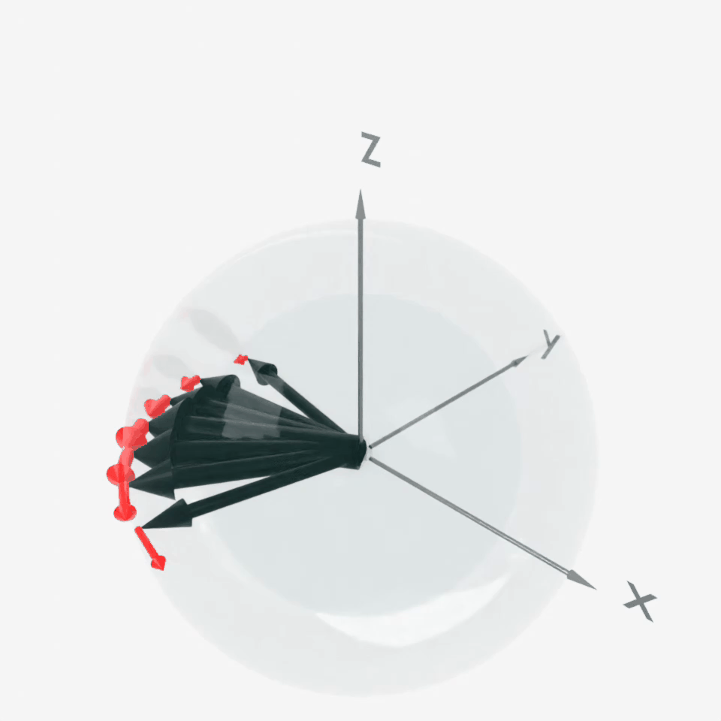
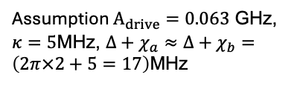
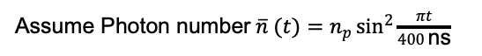
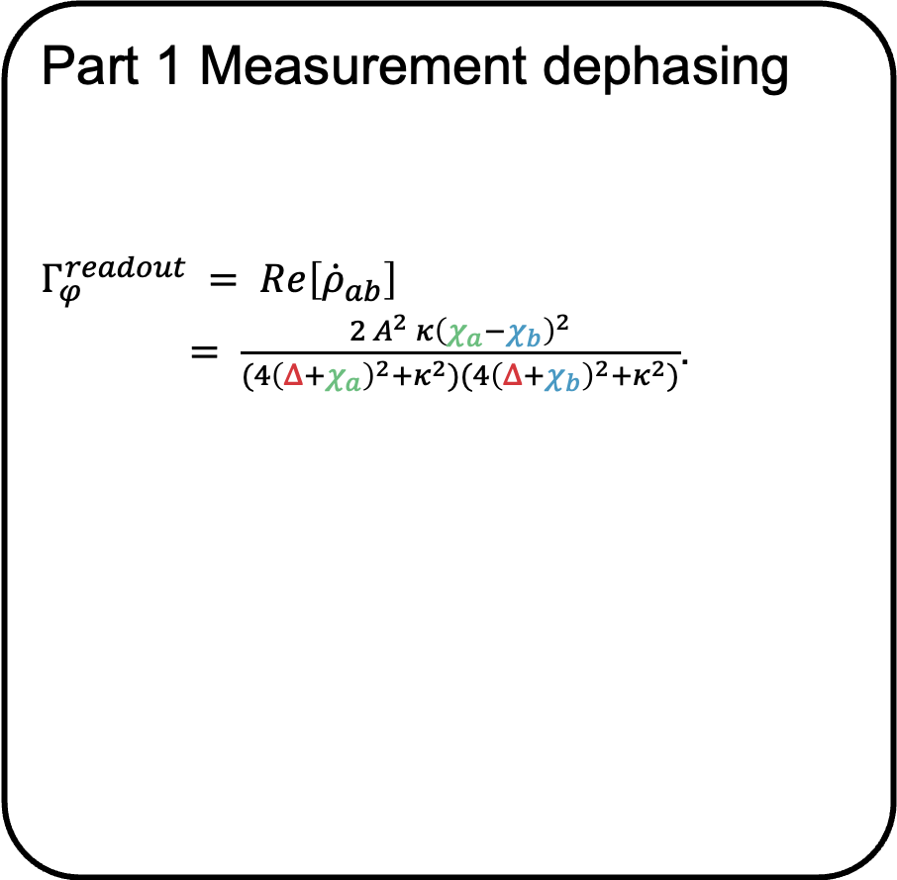
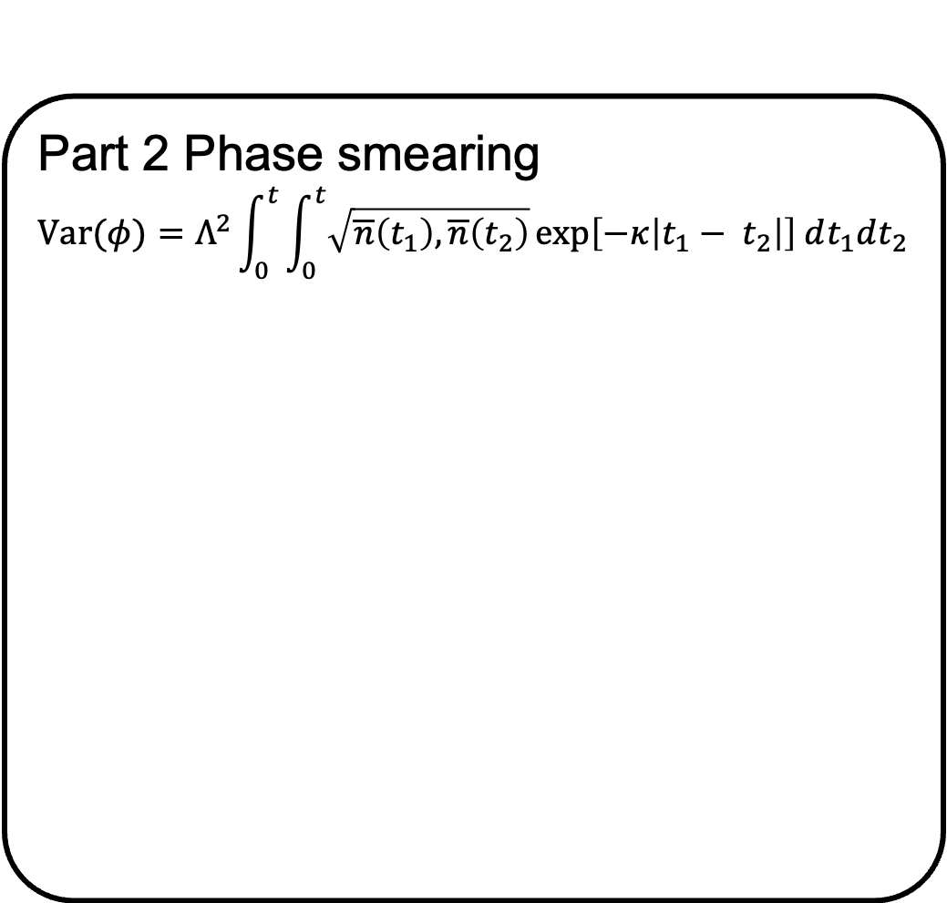

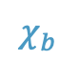
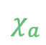
Dispersive erasure detection: Dephasing theory
Assume |a>,|b> are the two computational states
Part 1 Measurement dephasing
$$H(t) = ℏω_{r} a^{†}a + ℏω_{q}|\left.b\right\rangle \left\langle b\right.|+ ℏχ_{b} a^{†}a\left|\left.b\right\rangle \left\langle b\right.\right|$$
$$+ ℏχ_{a}a^{†}a|\left.a\right\rangle \left\langle a\right.|+ℏA cos(ω_{d}t) (a+a^{†}).$$
$$Γ_{φ}^{readout} = Re\left[{\dot{ρ}}_{ab}\right]$$
$= \frac{2 A^{2} κ{\left(χ_{a}−χ_{b}\right)}^{2}}{(4{\left(Δ+χ_{a}\right)}^{2}+κ^{2})(4{\left(Δ+χ_{b}\right)}^{2}+κ^{2})}$.
Part 2 Phase smearing
$$Var(φ)=Λ^{2}\int_{0}^{t}{\int_{0}^{t}{\sqrt{\overline{n}\left(t_{1}\right),\overline{n}\left(t_{2}\right)}}}exp\left[−κ\left|t_{1}− t_{2}\right|\right] dt_{1}dt_{2}$$
$$χ_{b}$$
$$χ_{a}$$
$$χ_{Leak}=−Δ$$
Assume $\text{Photon} \text{number} \overline{n} (t)=n_{p}\sin^{2}{\frac{πt}{400 \text{ns}}}$
Assumption $A_{drive}=0.063$ GHz, $κ=5\text{MHz}$, $Δ+χ_{a}≈Δ+χ_{b}=\left(2π×2+5=17\right)$MHz

Slide 7
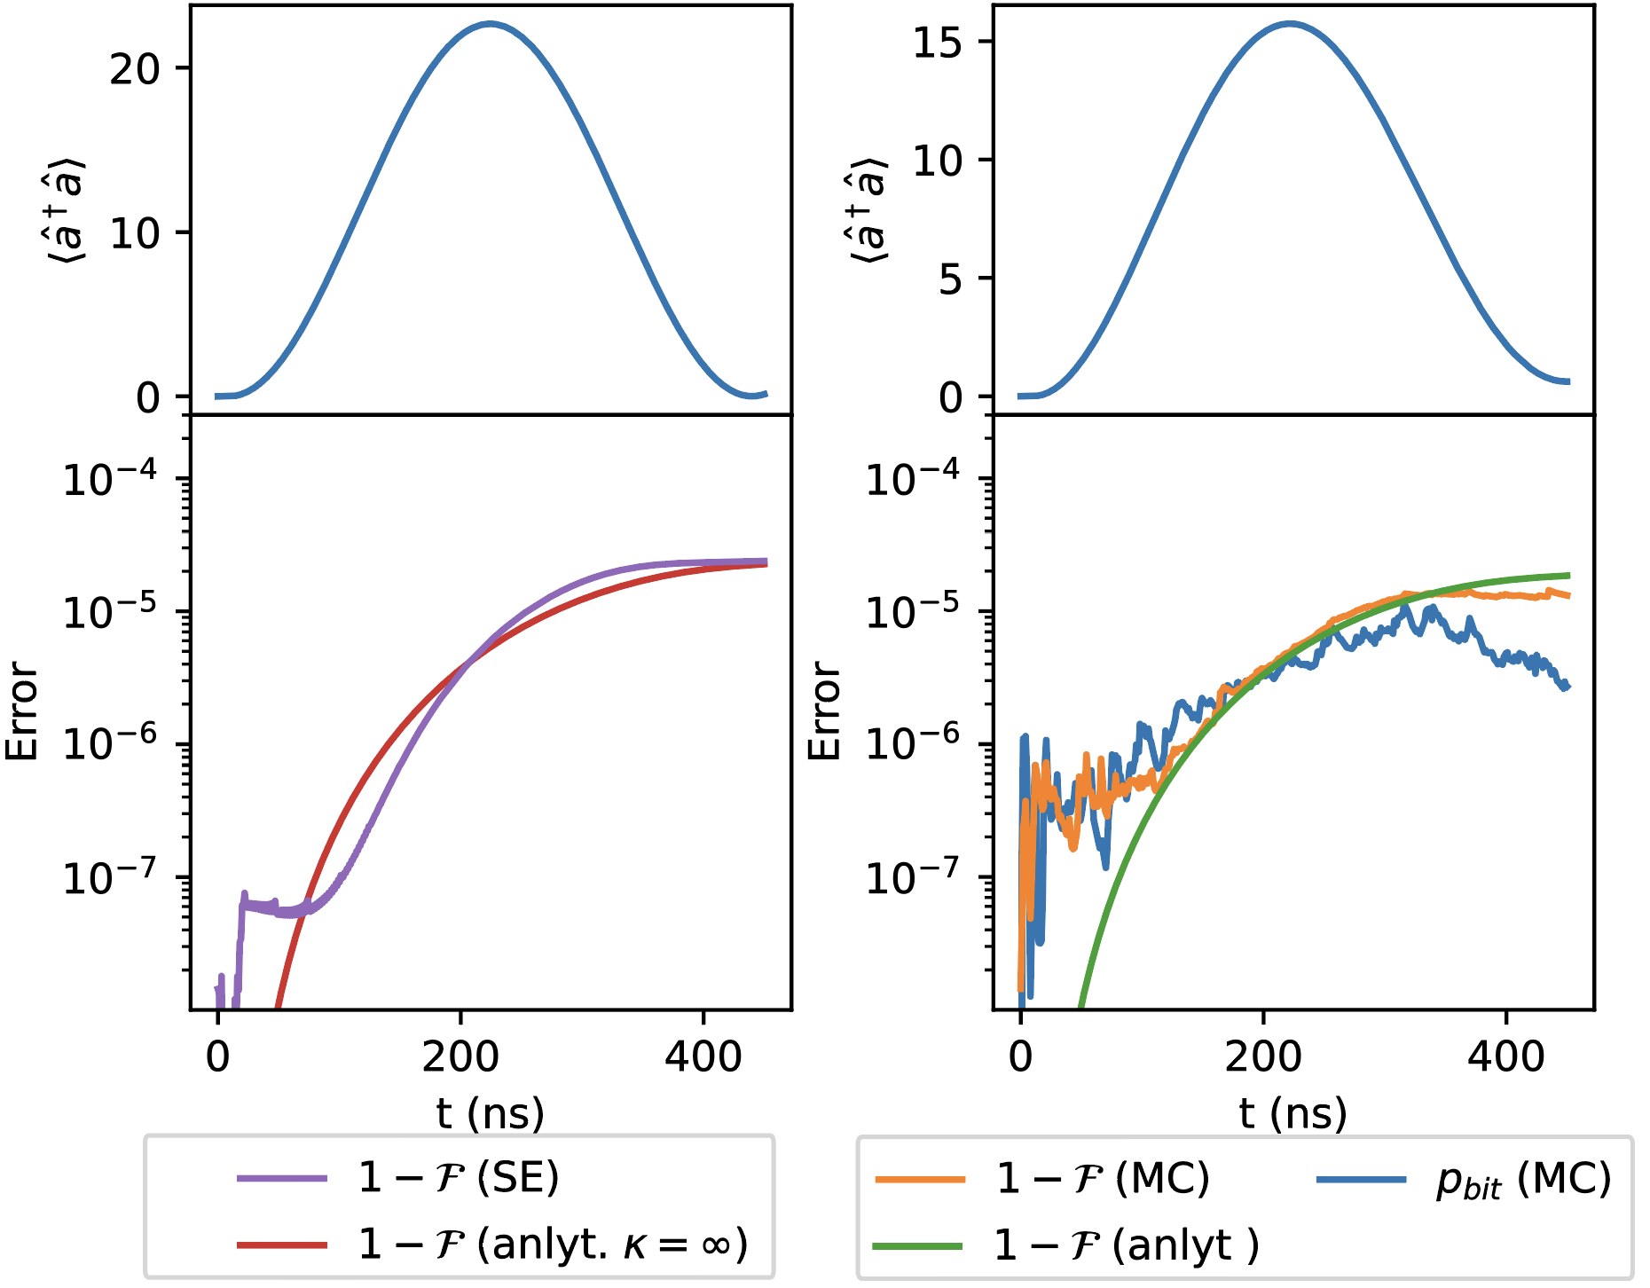
Dispersive erasure detection: dephasing from simulation
w/ out resonator decay
w/ resonator decay
Phase smearing is the major cause of dephasing

Slide 8


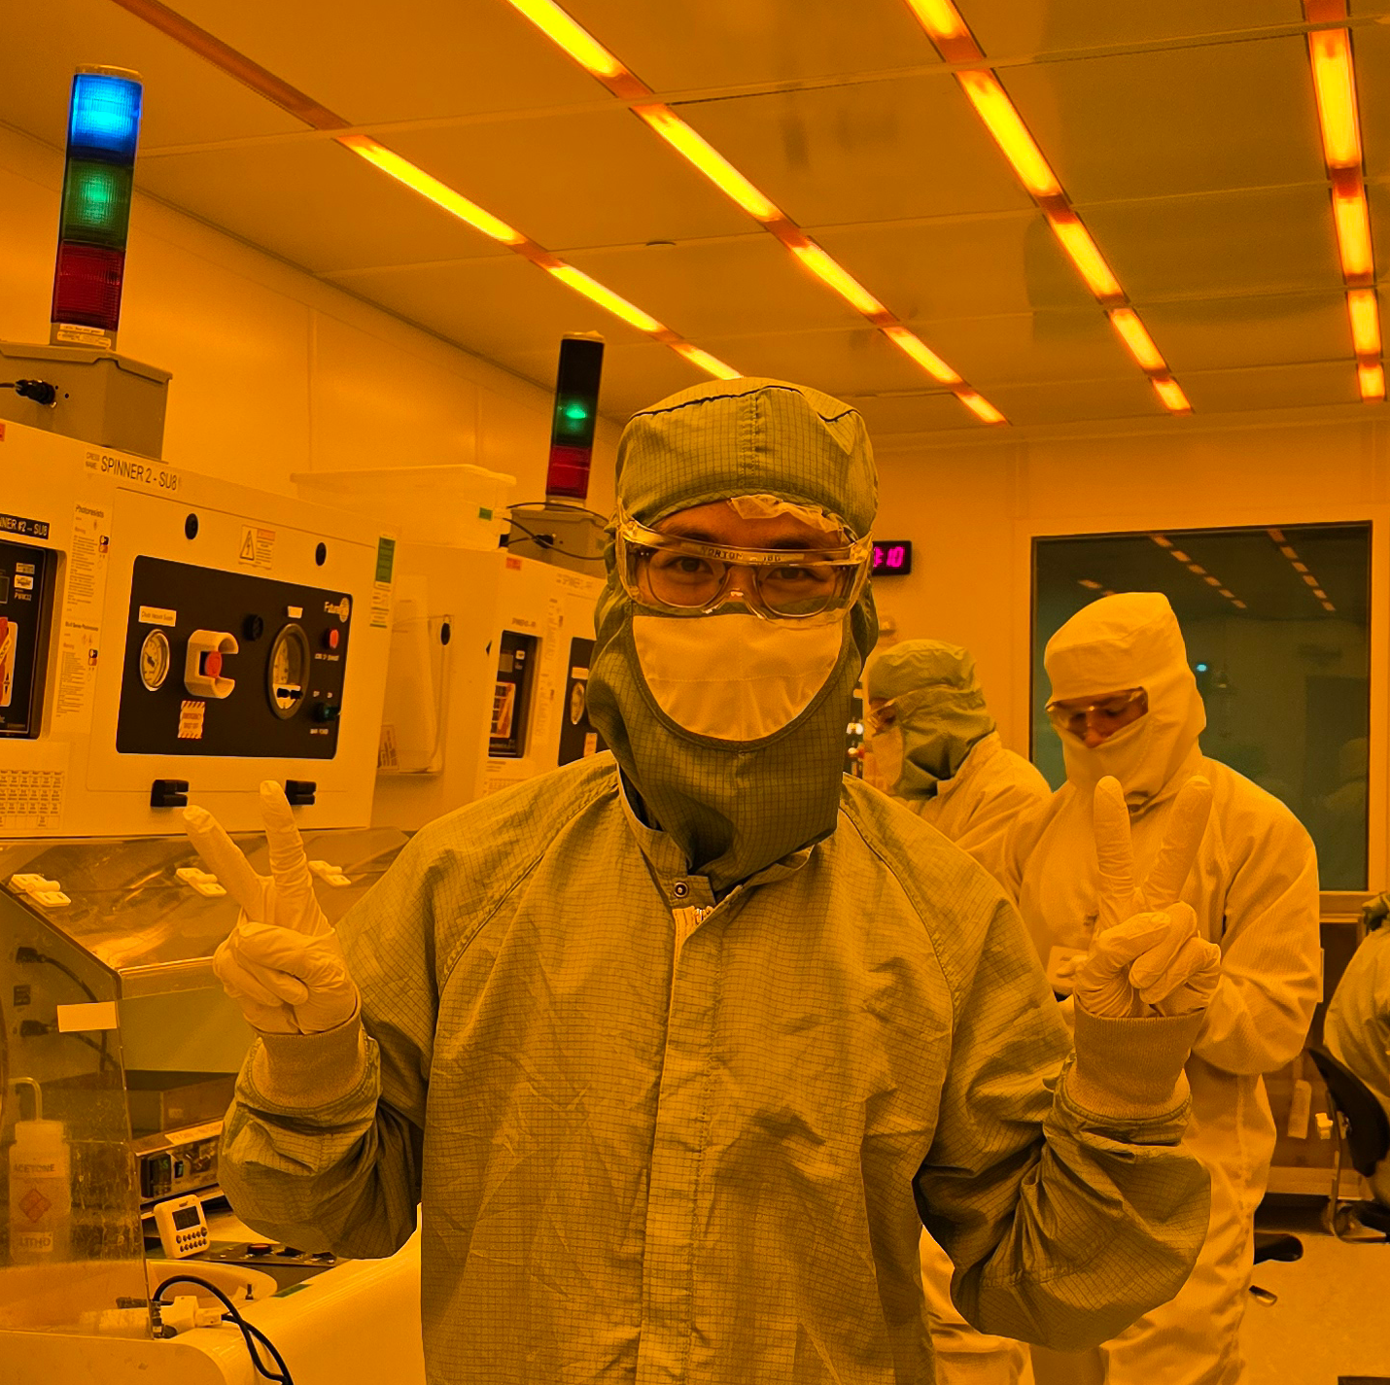
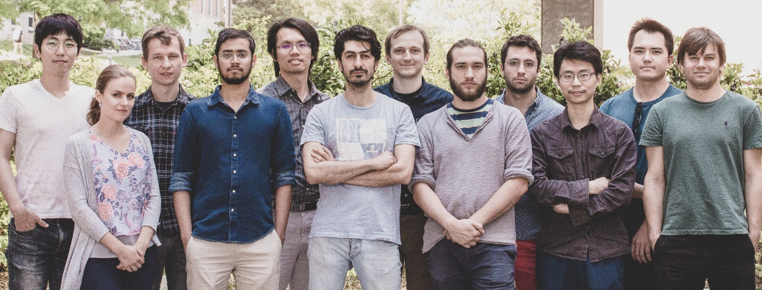

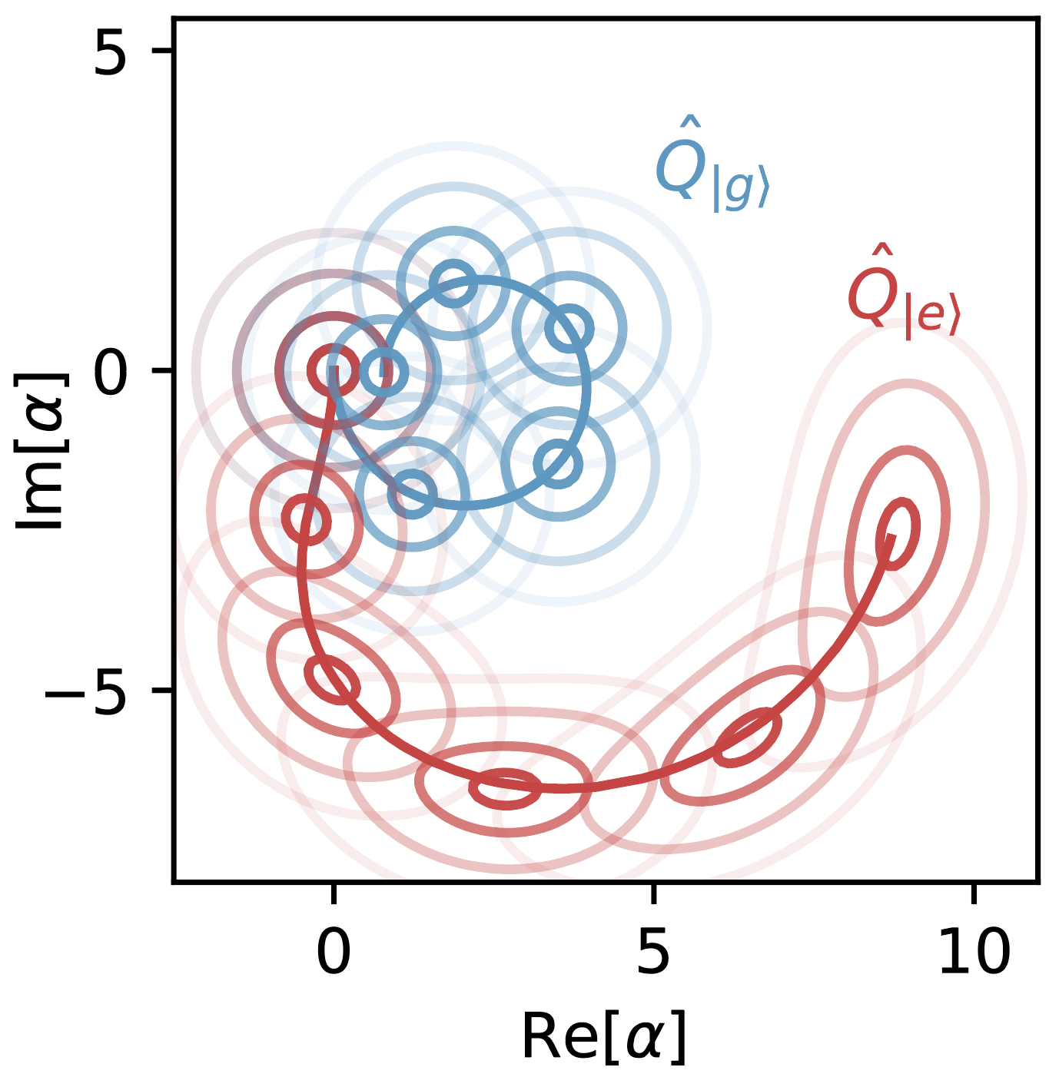
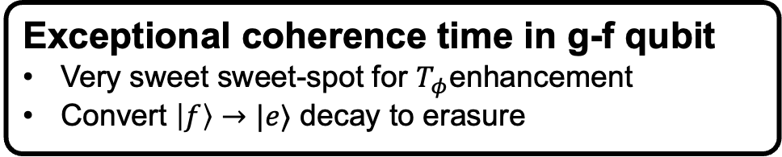
Summary
Jiakai Wang, Raymond Mencia, Vlad Manucharyan, Maxim Vavilov
Exceptional coherence time in g-f qubit
Very sweet sweet-spot for $T_{φ}$enhancement
Convert $\left|f\right\rangle →|e⟩$ decay to erasure
Leakage detection on single mode qubit via resonator readout
Characterized cause of dephasing, and estimated dephasing amount
Erasure-dominant gate
Detuned Raman drive reduces
undetectable error
Should also be applicable to
entangling gates
Raymond: Partial protection in superconducting qubits, March 18th, 4:12 pm, J18
Nick: Cross Resonant CNOT Gates in Hybrid Fluxonium-Transmon Systems, March 18th, 2:06 pm,
Tanvir: Implementation of CNOT and CPHASE gates between Fluxonium and Transmon Qubits, March 18th, 2:18 pm, G17
Hyunheung & Wei-Ju: Stable CNOT-gate on inductively-coupled fluxoniums with over 99.9% fidelity, March 21th , 8:12-8:36 am, W17

